Slide 1


End-to-end Layer Best-effort is not enough
SE3331-1 (2022 Fall)
IPADS, Shanghai Jiao Tong University
https://www.sjtu.edu.cn
xx

Slide 2
Review: Control-plane VS. Data-plane
Control-plane
Control the data flow by defining rules
E.g., the routing algorithm
Data-plane
Copies data according to the rules
Performance critical
E.g., the IP forwarding process

Slide 3
distance-vector routing: disseminate information about the current costs to each node, rather than the actual topology
link state distance vector
what’s in an advertisement
B
3
C
its link costs to each of its neighbors
its current costs to
every node it’s aware of
7
1
5
who gets a node’s advertisement
A
2
D
effectively, every other node (via flooding)
only its neighbors
4
1
3
what happens when things fail?
flooding makes link- state routing very resilient to failure
failures can be complicated because of timing
F
5
E
what limits scale?
the overhead of flooding
failure handling

Slide 4
NAT

Slide 5
NAT (Network Address Translation)
内网IP：10.*.*.*;192.168.*.*。
Private network
Public routers do not accept routes to network 10 (e.g., 10.8.8.8)
NAT router: bridge the private networks
Router between private & public network
Send: modify source address to temp public address(就是NAT网关的公网IP)
Receive: modify back by looking mapping table
Limitations
Some end-to-end protocols place address in payloads
The translator may become the bottleneck
What if two private network merge?
NAT网关的问题：会修改IP甚至port，
而port是上面一层end-to-end layer的
结构，所以说NAT破坏了网络协议的
层次结构。

Slide 6
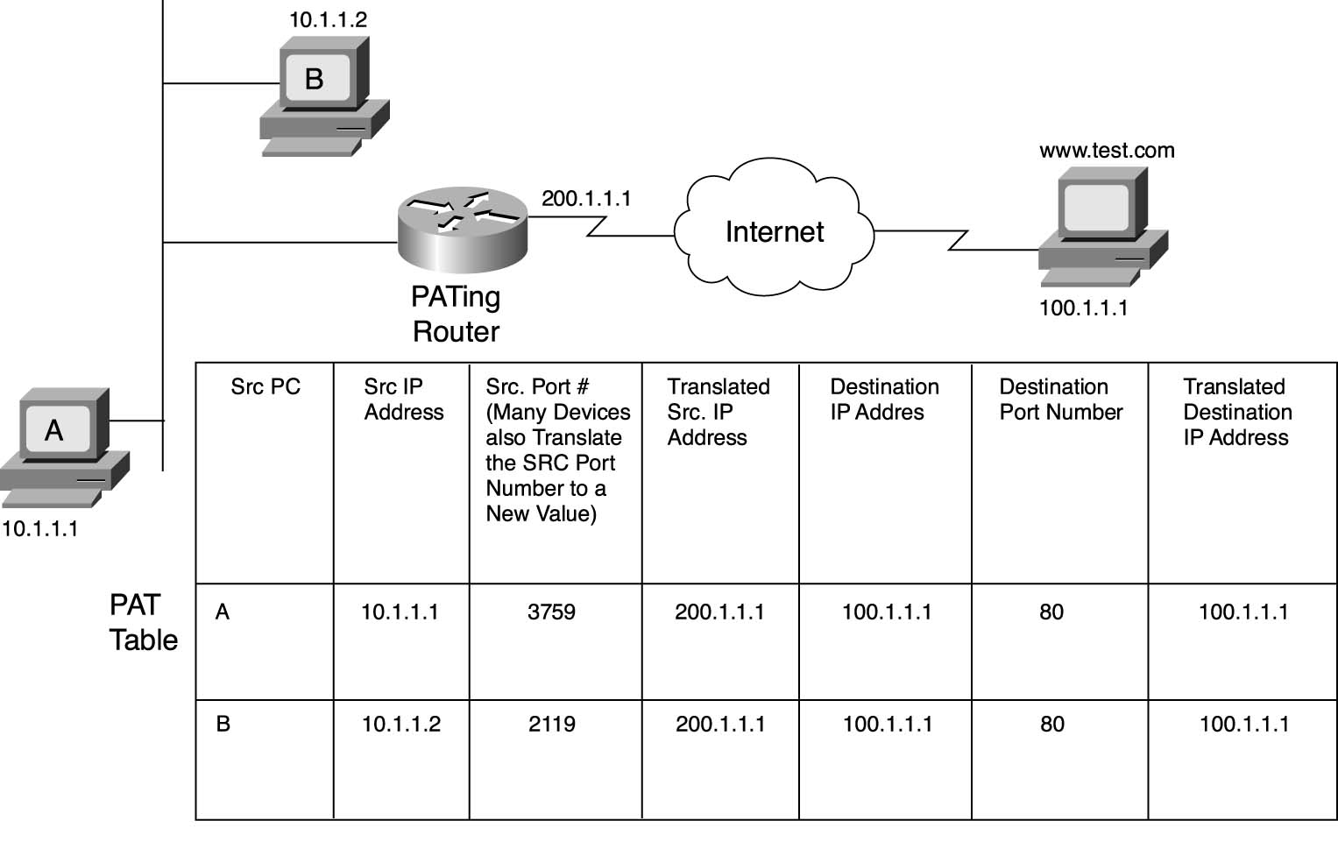
NAT

Slide 7
NAT中存储的route table最大长度为：
>65535。

Slide 8
CASE: Ethernet Mapping
Mapping Internet to Ethernet

Slide 9
Case Study: Mapping Internet to Ethernet
常识补充：
SSH <--> port 22
telnet <--> port 23
Listen-before-sending rule, collision
Ethernet: CSMA/CD
Carrier Sense Multiple Access with Collision Detection
Ethernet type
Experimental Ethernet, 3 mbps
Standard Ethernet, 10 mbps
Fast Ethernet, 100 mbps
Gigabit Ethernet, 1000 mbps

Slide 10
Overview of Ethernet
A half duplex Ethernet
The max propagation time is less than the 576 bit times, the shortest allowable packet
So that two parties can detect a collision together
If collision: wait random first time, exponential backoff if repeat
A full duplex & point-to-point Ethernet
No collisions & the max length of the link is determined by the physical medium

Slide 11
Difference between Hub and Switch
Hub
A frame is "broadcast" to every one of its ports
A 10/100Mbps hub must share its bandwidth with each port
Switch
Keeps a record of the MAC addresses of all the devices
A 10/100Mbps switch will allocate a full 10/100Mbps to each of its ports
常识：网卡的MAC地址是48位的，并且可以被修改，后面的例子可以看到

Slide 12
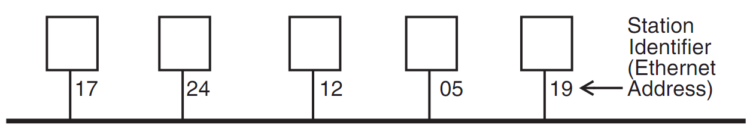
Broadcast Aspects of Ethernet
17是ethernet address。
Broadcast network(所有的包会被广播给同一个hub上面的所有其他ethernet)
Every frame is delivered to every station
(Compare with forwarding network)
ETHERNET_SEND
Pass the call along to the link layer
ETHERNET_HANDLE
Simple, can even be implemented in hardware

Slide 13
Broadcast Aspects of Ethernet
procedure ETHERNET_HANDLE (net_packet, length)
destination ← net_packet.target_id
if destination = my_station_id
then
GIVE_TO_END_LAYER (net_packet.data,
net_packet.end_protocol,
net_packet.source_id)
else
ignore packet
no need to do any forwarding

Slide 14
Broadcast Aspects of Ethernet
procedure ETHERNET_HANDLE (net_packet, length)
destination ← net_packet.target_id
if destination = my_station_id
or destination = BROADCAST_ID
then
GIVE_TO_END_LAYER (net_packet.data,
net_packet.end_protocol,
net_packet.source_id)
else
ignore packet

Slide 15
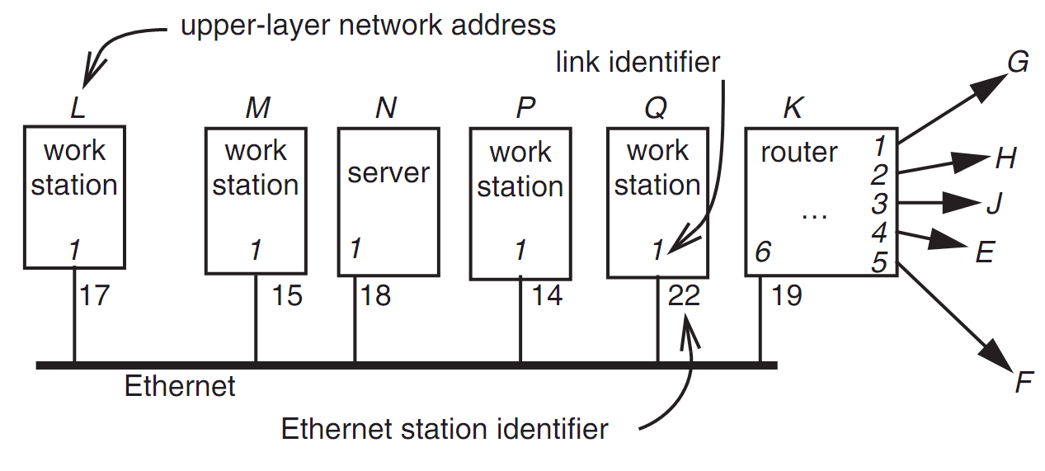
Layer Mapping: Attach Ethernet to Forwarding Network
两个不同IP的ethernet可以有相同的ethernet address，但是这两个ethernet位于不同网络下。需要通过layer-to-layer mapping。
15
L sends a RPC to N by sending to station 18 of link 1
L sends a RPC to E by sending to K, E may have 15 as address, as well as M

Slide 16
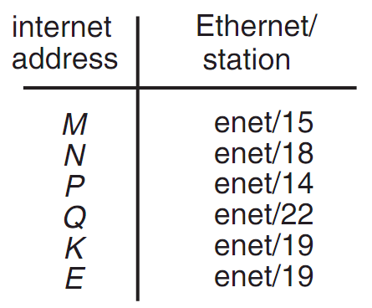
Layer Mapping
The Internet network layer
NETWORK_SEND (data, length, RPC, INTERNET, N)
NETWORK_SEND (data, length, RPC, ENET, 18)
L must maintain a table
注意E的mapping是ethernet 19！
因为E对于当前的hub而言只有通过19位置的router才能到达。

Slide 17
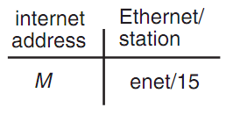
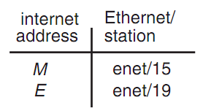
ARP (Address Resolution Protocol)
NETWORK_SEND ("where is M?", 11, ARP, ENET, BROADCAST)
NETWORK_SEND ("M is at station 15", 18, ARP, ENET, BROADCAST)
L asks E's Ethernet address, E does not hear the Ethernet broadcast, but the router at station 19 does, and it sends a suitable ARP response instead
Manage forwarding table as a cache

Slide 18
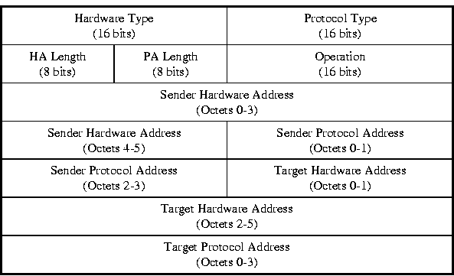
ARP & RARP Protocol
ARP:已知IP地址去获取ethernet address
RARP:已知ethernet address去获取IP address。
Name mapping: IP address <-> MAC address

Slide 19
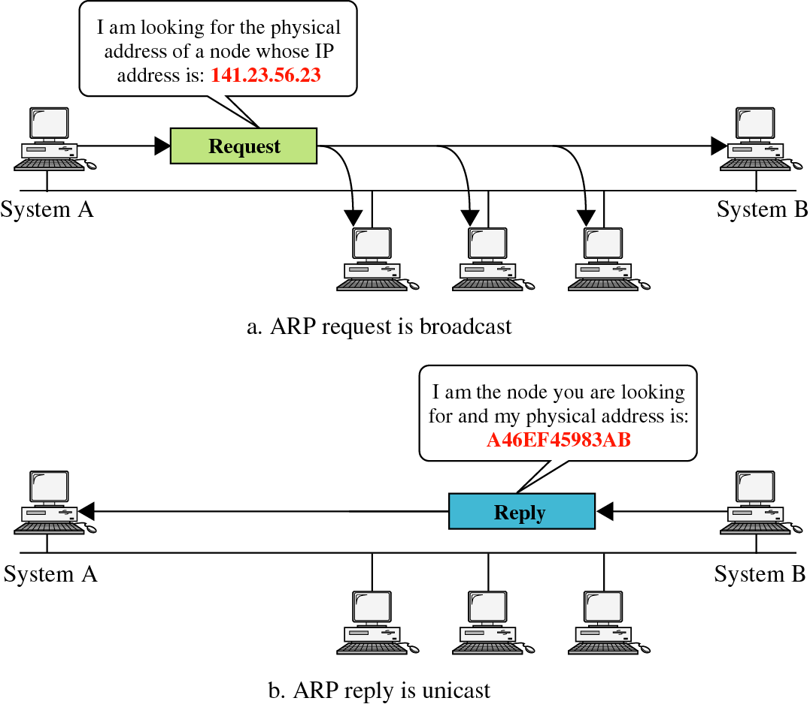
ARP & RARP

Slide 20
Network Topology
Take SJTU network for example
Subnet: usually like 192.168.0.2 or 10.0.0.2
Gateway: usually like 192.168.0.1
Get the global IP address: 202.120.40.82
A gateway usually has two (or more) IP address
Proxy: get proxy's address
E.g., 106.185.46.164 (Japan)

Slide 21
Network Topology

Slide 22
How to Use socket to Access www.baidu.com ?
You code as if your PC connect directly with Baidu
Call connect() with Baidu's IP address
But how does the system find next hop?

Slide 23
Putting All Together
App: I want to send a packet to Baidu, here is the packet with Baidu's IP in its header as target IP, and client's IP as source IP (Node-C)
OS: I don't know how to get to Baidu, I'll just send it to the router (gateway). But I cannot change the source IP of the packet, so I'll just change the MAC target address of the packet to the router's MAC address

Slide 24
Putting All Together
The router-1 (gateway): I get a packet with my MAC as target address. Is it my IP? No… So I'll just forward it to next hop, by changing the target MAC address to next hop's MAC address (NAT: change source IP and source port as well)
Router-2: I connect directly to Baidu, I'll just change the target MAC address to Baidu

Slide 25
ARP Spoofing(ARP诈骗)
Construct spoofed ARP replies
A target computer could be convinced to send frames destined for computer A to instead go to computer B
Computer A will have no idea that this redirection took place
This process of updating a target computer's ARP cache is referred to as "ARP poisoning"
ARP spoofing出现的根本原因是ARP protocol存在了问题，因为ARP协议中认为进行消息回复的那个node一定是”好”得，即不会发送虚假信息给消息的发出者。

Slide 26
Spoofed ARP reply
IP:10.0.0.2
MAC:cc:cc:cc:cc
Spoofed ARP reply
IP:10.0.0.2
MAC:cc:cc:cc:cc
switch
Spoofed ARP reply
IP:10.0.0.2
MAC:cc:cc:cc:cc
switch通信并没有采用广播机制，而是一种局部通信，即只有通过switch连接的节点才能通信，无直接连接的节点不能通信。
A
IP:10.0.0.1
MAC:aa:aa:aa:aa
B
IP:10.0.0.2
MAC:bb:bb:bb:bb
Hacker
IP:10.0.0.3
MAC:cc:cc:cc:cc
ARP cache
ARP cache
IP | MAC
10.0.0.2 | bb:bb:bb:bb
IP | MAC
10.0.0.1 | aa:aa:aa:aa

Slide 27
switch
A
IP:10.0.0.1
MAC:aa:aa:aa:aa
B
IP:10.0.0.2
MAC:bb:bb:bb:bb
Hacker
IP:10.0.0.3
MAC:cc:cc:cc:cc
A's cache is poisoned
ARP cache
ARP cache
IP | MAC
10.0.0.2 | cc:cc:cc:cc
IP | MAC
10.0.0.1 | aa:aa:aa:aa

Slide 28
ARP Spoofing
Now all the packets that A intends to send to B will go to the hacker's machine
Cache entry would expire, so it needs to be updated by sending the ARP reply again
How often?
depends on the particular system
Usually every 40s should be sufficient
In addition the hacker may not want his Ethernet driver talk too much
Accomplish with ifconfig -arp

Slide 29
Man-in-the-Middle Attack
A hacker inserts his computer between the communications path of two target computers
The hacker will forward frames between the two target computers so communications are not interrupted
E.g., Hunt, Ettercap, etc.
Can be obtained easily in many web archives

Slide 30
Man-in-the-Middle Attack
The attack is performed as follows:
Suppose X is the hacker's computer
T1 and T2 are the targets
X poisons the ARP cache of T1 and T2
T1 associates T2's IP with X's MAC
T2 associates T1's IP with X's MAC
All of T1 and T2's traffic will then go to X first, instead of directly to each other
为了防止被”识破”,attacker需要将接收到的包在转发给真正的target node。

Slide 31
Spoofed ARP reply
IP:10.0.0.2
MAC:cc:cc:cc:cc
Spoofed ARP reply
IP:10.0.0.2
MAC:cc:cc:cc:cc
switch
Spoofed ARP reply
IP:10.0.0.2
MAC:cc:cc:cc:cc
T1
IP:10.0.0.1
MAC:aa:aa:aa:aa
T2
IP:10.0.0.2
MAC:bb:bb:bb:bb
Hacker
IP:10.0.0.3
MAC:cc:cc:cc:cc
ARP cache
ARP cache
IP | MAC
10.0.0.2 | bb:bb:bb:bb
IP | MAC
10.0.0.1 | aa:aa:aa:aa

Slide 32
switch
T1
IP:10.0.0.1
MAC:aa:aa:aa:aa
T2
IP:10.0.0.2
MAC:bb:bb:bb:bb
Hacker
IP:10.0.0.3
MAC:cc:cc:cc:cc
ARP cache
ARP cache
IP | MAC
10.0.0.2 | cc:cc:cc:cc
IP | MAC
10.0.0.1 | aa:aa:aa:aa
T1's cache is poisoned

Slide 33
Forged ARP replies
IP:10.0.0.1
MAC:cc:cc:cc:cc
switch
Forged ARP replies
IP:10.0.0.1
MAC:cc:cc:cc:cc
T1
IP:10.0.0.1
MAC:aa:aa:aa:aa
T2
IP:10.0.0.2
MAC:bb:bb:bb:bb
Hacker
IP:10.0.0.3
MAC:cc:cc:cc:cc
ARP cache
ARP cache
IP | MAC
10.0.0.2 | cc:cc:cc:cc
IP | MAC
10.0.0.1 | aa:aa:aa:aa

Slide 34
switch
T1
IP:10.0.0.1
MAC:aa:aa:aa:aa
T2
IP:10.0.0.2
MAC:bb:bb:bb:bb
Hacker
IP:10.0.0.3
MAC:cc:cc:cc:cc
ARP cache
ARP cache
IP | MAC
10.0.0.2 | cc:cc:cc:cc
IP | MAC
10.0.0.1 | cc:cc:cc:cc
T2's cache is poisoned

Slide 35
Message intended to send to T2
switch
Hacker will
relay the
message
T1
IP:10.0.0.1
MAC:aa:aa:aa:aa
T2
IP:10.0.0.2
MAC:bb:bb:bb:bb
Hacker
IP:10.0.0.3
MAC:cc:cc:cc:cc
ARP cache
ARP cache
IP | MAC
10.0.0.2 | cc:cc:cc:cc
IP | MAC
10.0.0.1 | cc:cc:cc:cc

Slide 36
Hacker will relay the message
switch
Message
intended to
send to T1
T1
IP:10.0.0.1
MAC:aa:aa:aa:aa
T2
IP:10.0.0.2
MAC:bb:bb:bb:bb
Hacker
IP:10.0.0.3
MAC:cc:cc:cc:cc
ARP cache
ARP cache
IP | MAC
10.0.0.2 | cc:cc:cc:cc
IP | MAC
10.0.0.1 | cc:cc:cc:cc

Slide 37
Defenses against ARP Spoofing
No Universal defense(没有很好的解决方案) (!)
Use static ARP entries
Cannot be updated; Spoofed ARP replies are ignored
ARP table needs a static entry for each machine on the network
Large overhead
Deploying these tables; Keep the table up-to-date
Arpwatch
A free UNIX program which listens for ARP replies on a network
Build a table of IP/MAC associations and store it in a file
When a MAC/IP pair changes (flip-flop), an email is sent to an administrator

Slide 38
End-to-end Layer

Slide 39
The End-to-end Layer
Network layer has no guarantees on:
Delay - Order of arrival
Certainty of arrival - Accuracy of content
Right place to deliver
End-to-end layer
No single design is likely to suffice
Transport protocol for each class of application

Slide 40
Famous Transport Protocols
UDP (User Datagram Protocol)
Be used directly for some simple applications
Also be used as a component for other protocols
TCP (Transmission Control Protocol)
Keep order, no missing, no duplication
Provision for flow control
RTP (Real-time Transport Protocol)
Built on UDP
Be used for streaming video or voice, etc.
No "one size fits all"

Slide 41
Assurance of End-to-end Protocol
Assurance of at-least-once delivery
Assurance of at-most-once delivery
Assurance of data integrity
Assurance of stream order & closing of connections
Assurance of jitter control
Assurance of authenticity and privacy
Assurance of end-to-end performance

Slide 42
1. Assurance of At-least-once Delivery
RTT (Round-trip time)
to_time + process_time + back_time (ack)
At least once on best effort network
Send packet with nonce(可以理解为一个随机数,用于识别一个特定的网络包)
Sender keeps a copy of the packet
Resend if timeout before receiving acknowledge
Receiver acknowledges a packet with its nonce
Try limit(这个retry数量上限不可忽略!) times before returning error to app

Slide 43
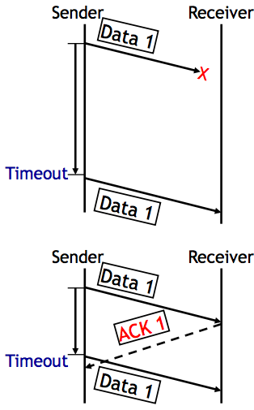
1. Assurance of At-least-once Delivery
Dilemma
1. The data was not delivered
2. The data was delivered, but no ACK received
No way to know which situation
At-least-once delivery
No absolute assurance for at-least-once
Ensure if it is possible to get through, the message will get through eventually
Ensure if impossible to confirm delivery, app will know
No assurance for no-duplication

Slide 44
How to Decide Timeout?
Fixed timer: dilemma of fixed timer
Too short? unnecessary resend
Too long? take long time to discover lost packets
Adaptive timer
E.g., adjust by currently observed RTT, set timer to 150%
Exponential back-off: doubling from a small timer
NAK (Negative AcKnowledgment)
Receiver sends a message that lists missing items
Receiver can count arriving segments rather than timer
Sender can have no timer (only once per stream)

Slide 45
Fixed Timer is Evil
Fixed timers lead to congestion collapse in NFS
Emergent phase synchronization of periodic protocols
Wisconsin time server meltdown

Slide 46
Emergent Phase Synchronization of Periodic Protocols
Periodic polling
E.g. picking up mail, sending "are-you-there?"
A workstation sends a broadcast packet every 5 minutes
All workstations try to broadcast at the same time
Each workstation
Send a broadcast
Set a fixed timer
Lesson: Fixed timers have many evils. Do not assume that unsynchronized periodic activities will stay that way

Slide 47
Wisconsin Time Server Meltdown
NETGEAR added a feature to wireless router
Logging packets -> timestamp -> time server (SNTP) -> name discovery -> 128.105.39.11
Once per second (!) until receive a response
Once per minute or per day after that
Wisconsin Univ.
On May 14, 2003, at about 8:00 am
From 20,000 to 60,000 requests per second, filtering 23457
After one week, 270,000 requests per second, 150Mbps

Slide 48
Wisconsin Time Server Meltdown
Lesson(s)
Fixed timers, again
Fixed Internet address
The client implements only part of a protocol
There is a reason for features likes the "go away" response in SNTP

Slide 49
How to Decide Timeout?
Fixed timer: dilemma of fixed timer
Too short: unnecessary resend
Too long: take long time to discover lost packets
Adaptive timer
E.g., adjust by currently observed RTT, set timer to 150%
Exponential back-off: doubling from a small timer
NAK (Negative AcKnowledgment)
Receiver sends a message that lists missing items
Receiver can count arriving segments rather than timer
Sender can have no timer (only once per stream)

Slide 50
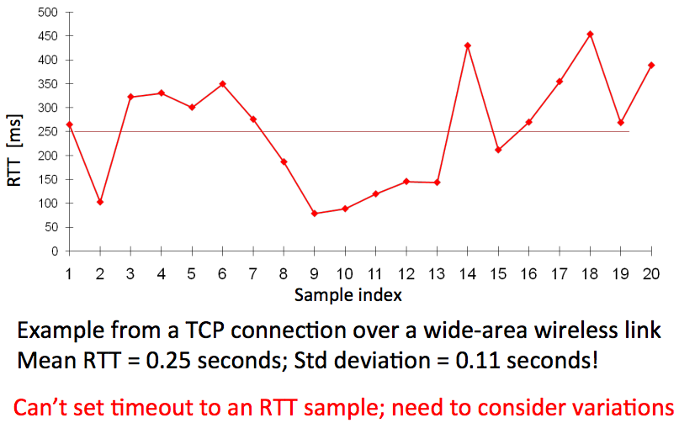
RTT Could be Highly Variable

Slide 51
Calculating RTT and Timeout (in TCP)
Exponentially Weighted Moving Average
Estimate both the average rtt_avg and the deviation rtt_dev
Procedure calc_rtt(rtt_sample)
rtt_avg = a*rtt_sample + (1-a)*rtt_avg; /* a = 1/8 */
dev = absolute(rtt_sample – rtt_avg);
rtt_dev = b*dev + (1-b)*rtt_dev; /* b = 1/4 */
Procedure calc_timeout(rtt_avg, rtt_dev)
Timeout = rtt_avg + 4*rtt_dev

Slide 52
How to Decide Timeout?
Fixed timer: dilemma of fixed timer
Too short: unnecessary resend
Too long: take long time to discover lost packets
Adaptive timer
E.g., adjust by currently observed RTT, set timer to 150%
Exponential back-off: doubling from a small timer
NAK (Negative AcKnowledgment)
Receiver sends a message that lists missing items
Receiver can count arriving segments rather than timer
Sender can have no timer (only once per stream)

Slide 53
2. Assurance of At-most-once Delivery
At-least-once delivery
Remember state at the sending side
Tends to generate duplicated requests
At-most-once delivery
Maintains a table of nonce at the receiving side
The table may grow indefinitely
Space and search time
Tombstones (something that cannot be deleted forever)
Another way: Make the application tolerate duplicated requests
Recall the NFS collapse case: server wastes time to execute duplicated requests

Slide 54
Duplicate Suppression
Monotonically increasing sequence number
Receiver discards smaller nonce, only holds the last nonce, one per sender
Now, the old nonce is a tombstone!
Use a different port for each new request
Should never reuse the old port number
But, the old port is now tombstone!

Slide 55
Duplicate Suppression
Accept the possibility of making a mistake
E.g., if sender always gives up after five RTT (cannot ensure at-least-once), then receiver can safely discard nonces that are older than five RTT
It is possible that a packet finally shows up after long delay (solution: wait long time)
Receiver crashes and restarts: lose the table
One solution is to use a new port number each time the system restarts
Another is to ignore all packets until the number of RTT has passed since restarting, if sender tries limit times
Anyway, duplicate suppression makes the system complex

Slide 56
3. Assurance of Data Integrity
Data integrity
Receiver gets the same contents as sender
Reliable delivery protocol
Sender: adds checksum to the end-to-end layer
Receiver: recalculates the checksum, discards if not match
Q: Is it redundant since link layer provides checksum?
No. Besides network, there could be other errors, e.g., in memory copying
The assurance is not absolute
What if a packet is mis-delivered and the receiver ACK?

Slide 57
4. Segments and Reassembly of Long Messages
Bridge the difference between message and MTU
Message length: determined by application
MTU: determined by network
Segment contains ID for where it fits
E.g., "message 914, segment 3 of 7"
Can be used for at-least-once and at-most-once delivery
Reassembly
Out-of-order, mingled with other message's segments
Allocating a buffer large enough to hold the message

Slide 58
When Out of Order…
Solution-1: Receiver only ACK in order packets, discards others
Waste of bandwidth
Solution-2: ACK every packet and hold early packets in buffer, release the buffer when all in order
Need using large buffer when waiting for a bad packet
Solution-3: Combine the two above
Discard if buffer is full
New problem: how much buffer?
Speedup for common case
NAK to avoid timeout
If NAKs are causing duplicates, stop NAKs
TCP is based on ACK, not NAK

Slide 59
Closing of Connections
Open a stream
Create a record to keep track of which elements have been sent, received, acknowledged
Close a stream
When finish, it needs to report an end-of-stream
Both ends need to agree last element is OK and then close
1. Alice sends close request to Bob with stream record ID
2. Bob checks and agrees, sends a close ACK
3. Alice receives ACK, turn off sender, discard record
4. Alice sends "all done" to Bob
5. Bob receives "all done" and discard stream record
<- What if duplicate?

Slide 60
5. Assurance of Jitter Control
Real-time
When reliability is less important than timely delivery
A few error in a movie may not be noticed
Jitter: variability in delivery time
Strategy
Basic: delay all arriving segments

Slide 61
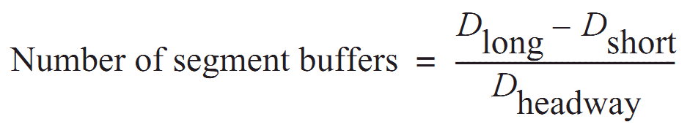
5. Assurance of Jitter Control
Measure the distribution of delays in a chart showing delay time vs. frequency of that delay
Choose an acceptable frequency of delivery failure
Determine D_{long} that longer than 99% delay
Determine the shortest delay, D_{short}
Calculate number of segment buffer:
D_{headway} is average delay between arriving segments

Slide 62
6. Assurance of Authenticity and Privacy
Internet is dangerous
Hostile intercepts and maliciously modifies packets
Violate a protocol with malicious intent
Key-based mathematical transformations to data
Sign and verify: establish the authenticity of the source and integrity of contents
Encrypt and decrypt: maintain privacy of contents
Consideration
False sense of security, worse than no assurance

Slide 63
6. Security: Asymmetric Encryption
Public Key VS. Private Key
Public key: encrypt to identify reader (only me can read this)
Private key: encrypt to identify writer (yes, it's me who wrote this)
Poor performance, so just used to exchange symmetric key
Questions
What is a certificate? Why using a CA (Certificate Authority)?
How to exchange a symmetric key in HTTPS or SSH?
What is the root of trust?
Will be addressed later, in Security part

Slide 64
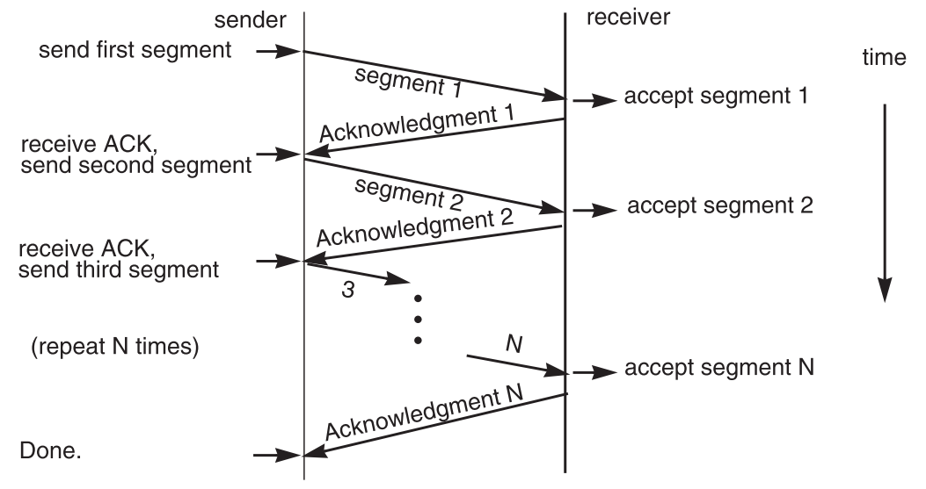
7. End-to-end Performance
Multi-segment message questions
Trade-off between complexity and performance
Lock-step protocol

Slide 65
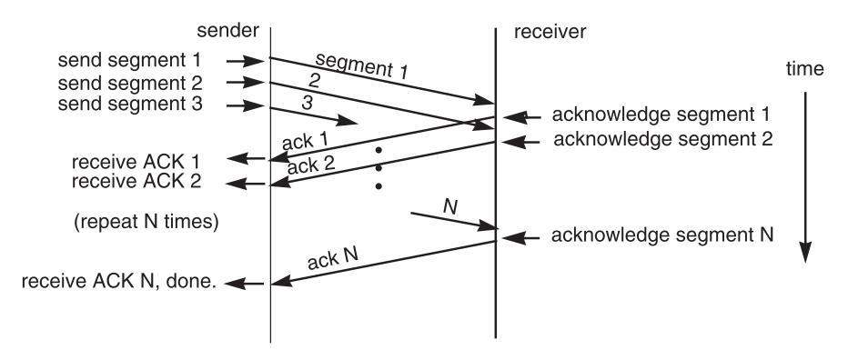
Overlapping Transmissions
Pipelining technique

Slide 66
Overlapping Transmissions
Packets or ACK may be lost
Sender holds a list of segments sent, check it off when receives ACK
Set a timer (according to RTT) for last segment
If list of missing ACK is empty, OK
If timer expires, resend packets and another timer

Slide 67
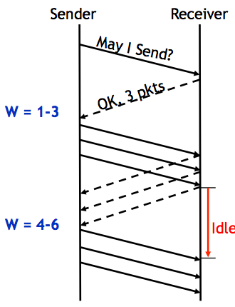
Fixed Window
Receiver tells the sender a window size
Sender sends window
Receiver acks each packet as before
Window advances when all packets in previous window are acked
E.g., packets 4-6 sent, after 1-3 ack'd
If a packet times out -> resend packets
Still much idle time

Slide 68
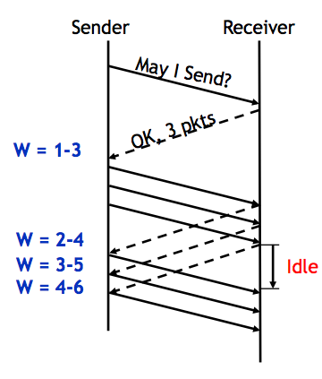
Sliding Window
Sender advances the window by 1 for each in-sequence ACK it receives
Reduces idle periods
Pipelining idea
But what's the correct value for the window?
We'll revisit this question
First, we need to understand windows

Slide 69
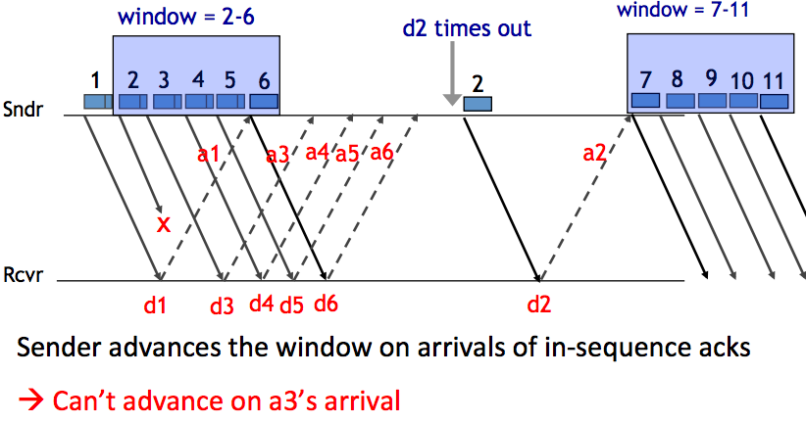
Handling Packet Loss

Slide 70
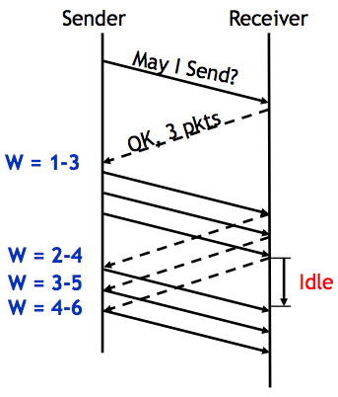
Chose the Right Window Size
If window is too small
Long idle time
Underutilized network
If window too large
Congestion

Slide 71
Sliding Window Size
window size ≥ round-trip time × bottleneck data rate
Sliding window with one segment in size
Data rate is window size / RTT
Enlarge window size to bottleneck data rate
Data rate is window size / RTT
Enlarge window size further
Data rate is still bottleneck
Larger window makes no sense
- Receive 500 KBps
- Sender 1 MBps
- RTT 70ms
- A segment carries 0.5 KB
- Sliding window size = 35KB (70 segment)

Slide 72
Self-pacing: Sliding Window Size
Although the sender doesn't know the bottleneck, it is sending at exactly that rate
Once sender fills a sliding window, cannot send next data until receive ACK of the oldest data in the window
The receiver cannot generate ACK faster than the network can deliver data elements
RTT estimation still needed

Slide 73
TCP Congestion Control

Slide 74
Congestion
Definition: Too many packets present in (a part of) the network causes packet delay and loss that degrades performance.
Network & End-to-end layers share the responsibility for handling congestion
1. Network layer
Directly experiences the congestion
Ultimately determine what to do with the excess packets
2. End-to-end layer
Control to reduce the sending rate, is the most effective way

Slide 75
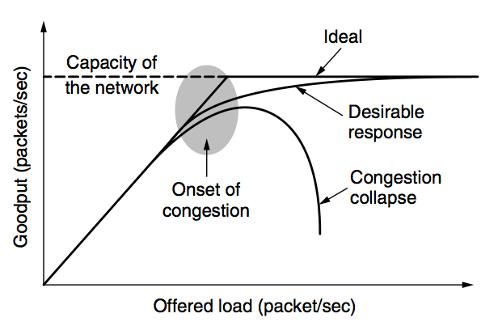
Network Congestion

Slide 76
Why Congest?
If all of a sudden, streams of packets begin arriving on three or four input lines and all need the same output line, a queue will build up
If there is insufficient memory to hold all of them, packets will be lost
Adding more memory may help up to a point, but
Nagle (1987) realized that if routers have an infinite amount of memory, congestion gets worse, not better
This is because by the time packets get to the front of the queue, they have already timed out (repeatedly) and duplicates have been sent

Slide 77
Load Shedding: Setting Window Size
For performance:
window size ≥ round-trip time × bottleneck data rate
For congestion control:
window size ≤ min(RTT x bottleneck data rate, Receiver buffer)
Congestion window
2 windows become 1
to achieve best performance and avoid congestion

Slide 78
Congestion Control
Basic idea:
Increase congestion window slowly
If no drops -> no congestion yet
If a drop occurs -> decrease congestion window quickly
Use the idea in a distributed protocol that achieves:
Efficiency: i.e., uses the bottleneck capacity efficiently
Fairness, i.e., senders sharing a bottleneck get equal throughput (if they have demands)

Slide 79
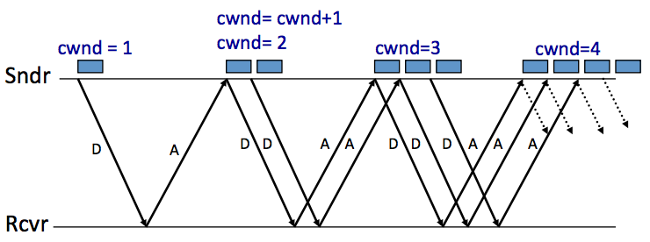
AIMD (Additive Increase, Multiplicative Decrease)
Every RTT:
No drop: cwnd = cwnd + 1
A drop: cwnd = cwnd / 2

Slide 80
Problems with AIMD
Increases very slowly at the beginning
Initial window size is 1
Probably too small in practice
Solution: do multiplicative increase at the beginning
Congestion_window _{init} = 1
Initially, do Congestion_window ← 2 * Congestion_window each RTT until we hit congestion
Named "slow start" (even though it's exponentially fast!)

Slide 81
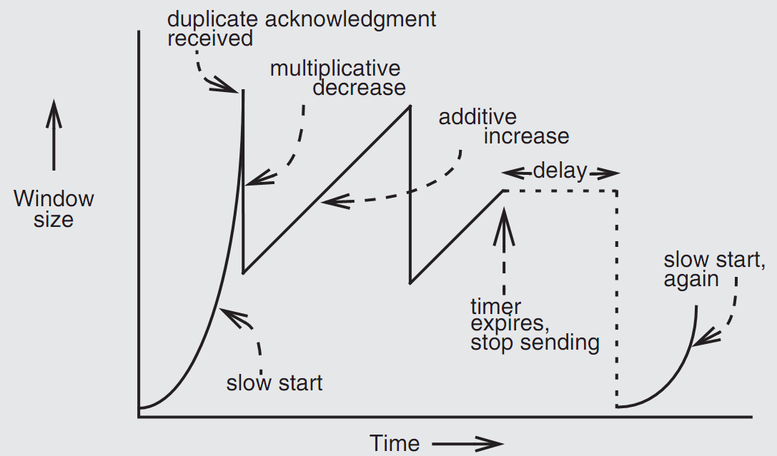
Retrofitting TCP

Slide 82
Retrofitting TCP
1. Slow start: one packet at first, then double until
Sender reaches the window size suggested by the receiver
All the available data has been dispatched
Sender detects that a packet it sent has been discarded
2. Duplicate ACK
When receiver gets an out-of-order packet, it sends back a duplicate of latest ACK
3. Equilibrium
Additive increase & multiplicative decrease
4. Restart, after waiting a short time

Slide 83
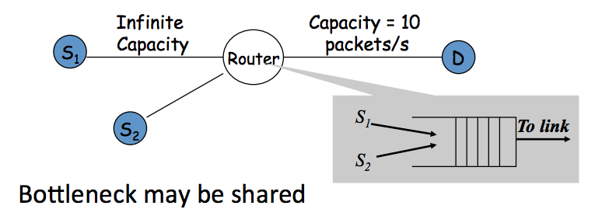
Fairness between Links

Slide 84
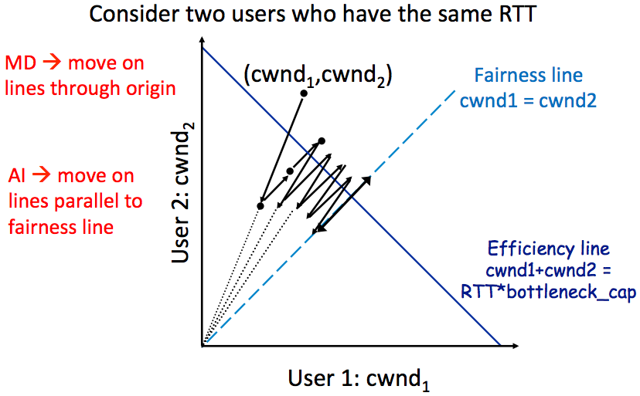
AIMD Leads to Efficiency and Fairness

Slide 85
Q: Why not Additive Decrease
It does not converge to fairness
from a congested point, (x',y'), reducing each by 1 worsens fairness and takes us away from the "ideal" outcome

Slide 86
Weakness of TCP
If routers have too much buffering, causes long delays
Packet loss is not always caused by congestion
Consider wireless network: if losing packet, sender may send faster instead
TCP does not perform well in datacenters
High bandwidth, low delay situations
TCP has a bias against long RTTs
Throughput inversely proportionally to RTT
Consider when sending packets really far away vs really close
Assumes cooperating sources, which is not always a good assumption

Slide 87
Summary of Congestion Window
Reliability Using Sliding Window
Tx Rate = W / RTT
Congestion Control
W = min(Receiver_buffer, cwnd)
Congestion window is adapted by the congestion control protocol to ensure efficiency and fairness
TCP congestion control uses AIMD which provides fairness and efficiency in a distributed way

